Slide 1
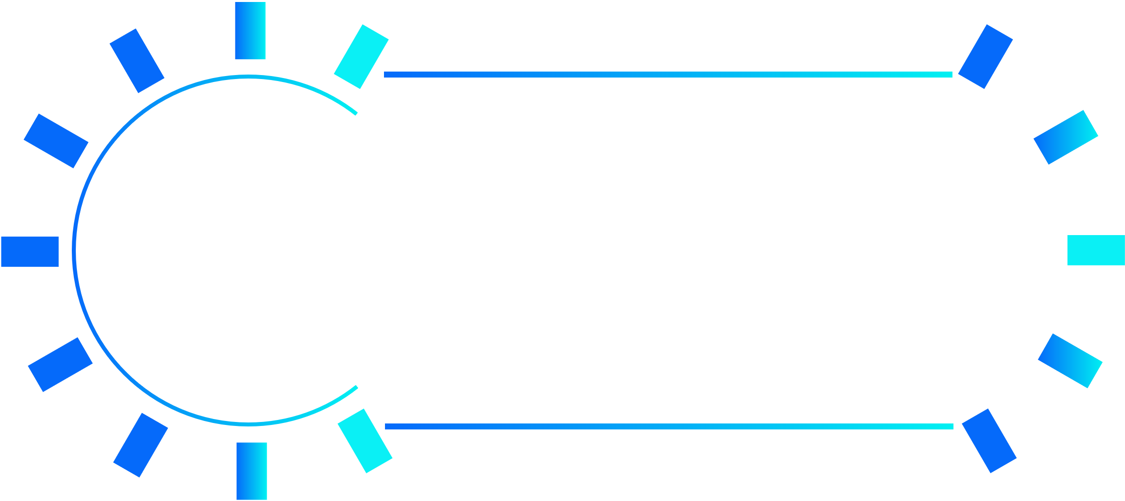


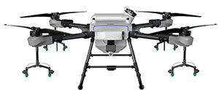
Company Profile
YUEQUN was firstly established in 2009 and formally registered in 2015. With more than 10 years of experience in flight control development and manufacture, YUEQUN has expanding our technologies to produce UAV and peripherals including sensors, pods, apps, software and cloud service system. Our products are widely used for agricultural purposes, power line inspection, delivery, etc.
R&D takes up more than 60% of the 200 employees in our company. YUEQUN boasts a team of talents graduated from world-known aeronautics and astronautic universities such as NUAA and Beihang University， who have rich knowledge and experience in designing UAV，military aircraft, and large aircraft.

Slide 2
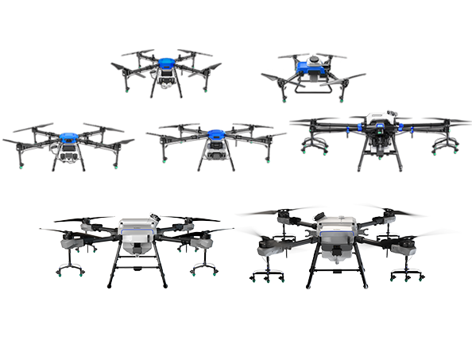
Company Profile
Since it was founded, YUEQUN has been making technological breakthrough, with 300+ intellectual properties and 200+ patents being filed. YUEQUN owns qualifications including High Technology Enterprise Certificate，ISO9001, ISO20000, ISO27001, etc. Our UAVs has passed international tests such as CE，FCC，ROHS and KC.
Currently focusing on drones for plant protection，YUEQUN has been optimizing products according to agricultural professionals’ feedback. Now 20000+ sets of YUEQUN flight controls have been sold to 400+ domestic and 100+ overseas clients, which include Japan, Korea, Thailand, Australia and other countries in East Asia and North America.

Slide 3
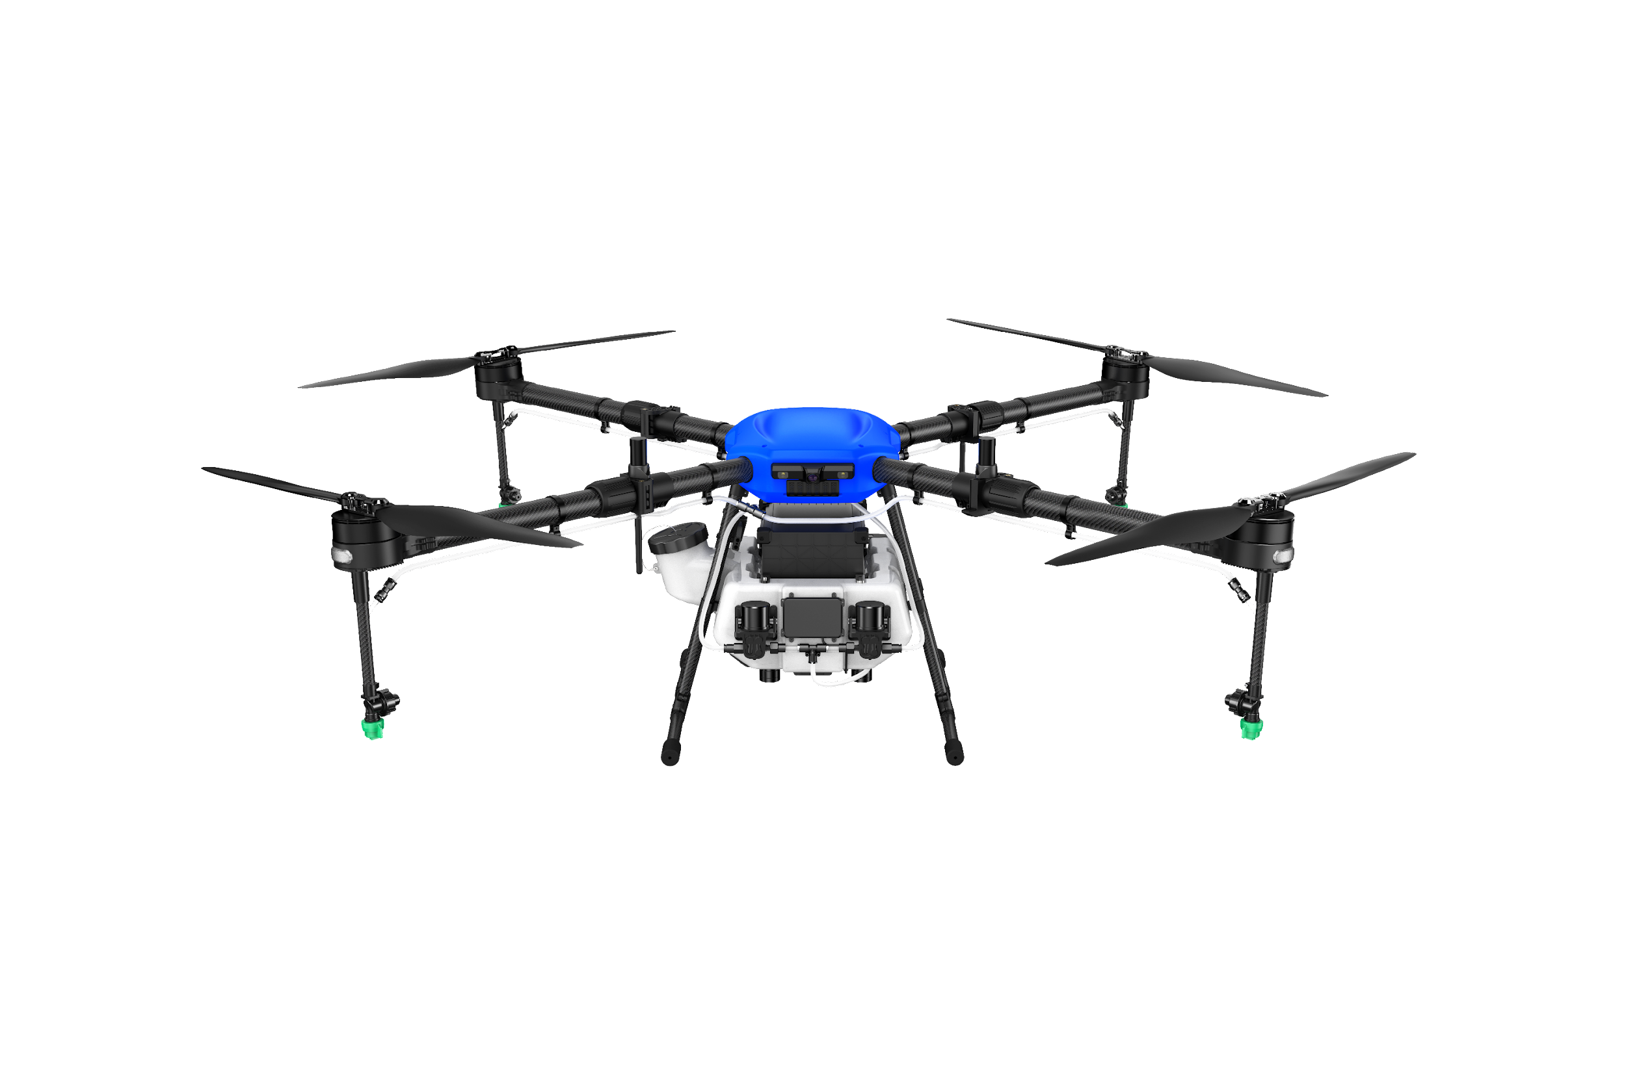
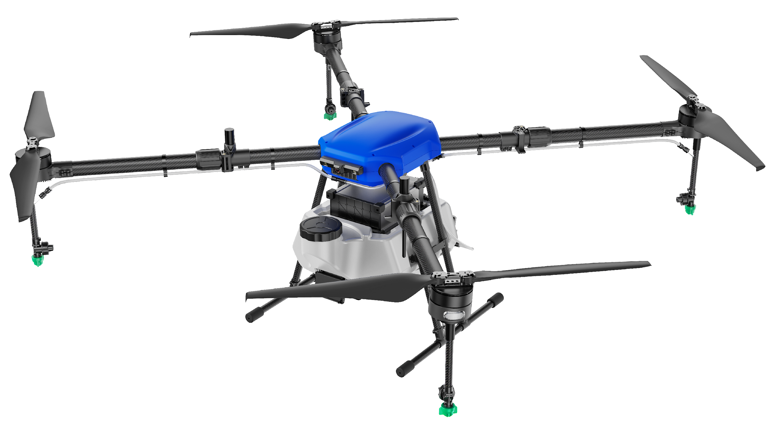
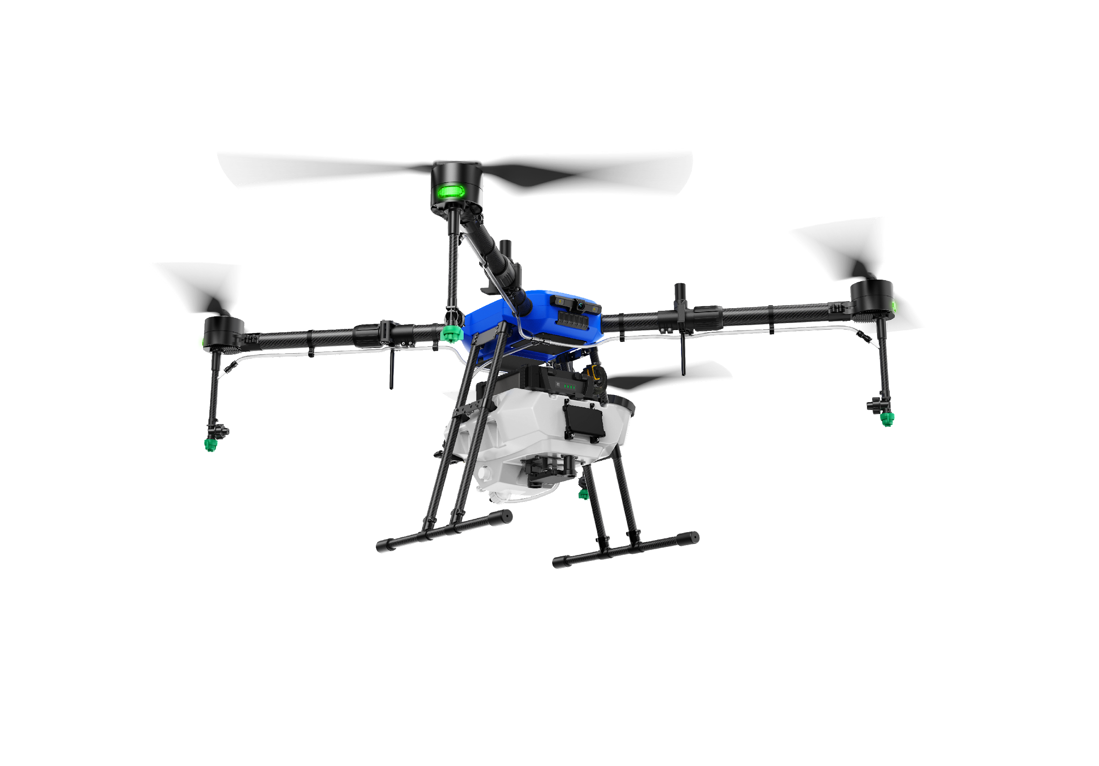
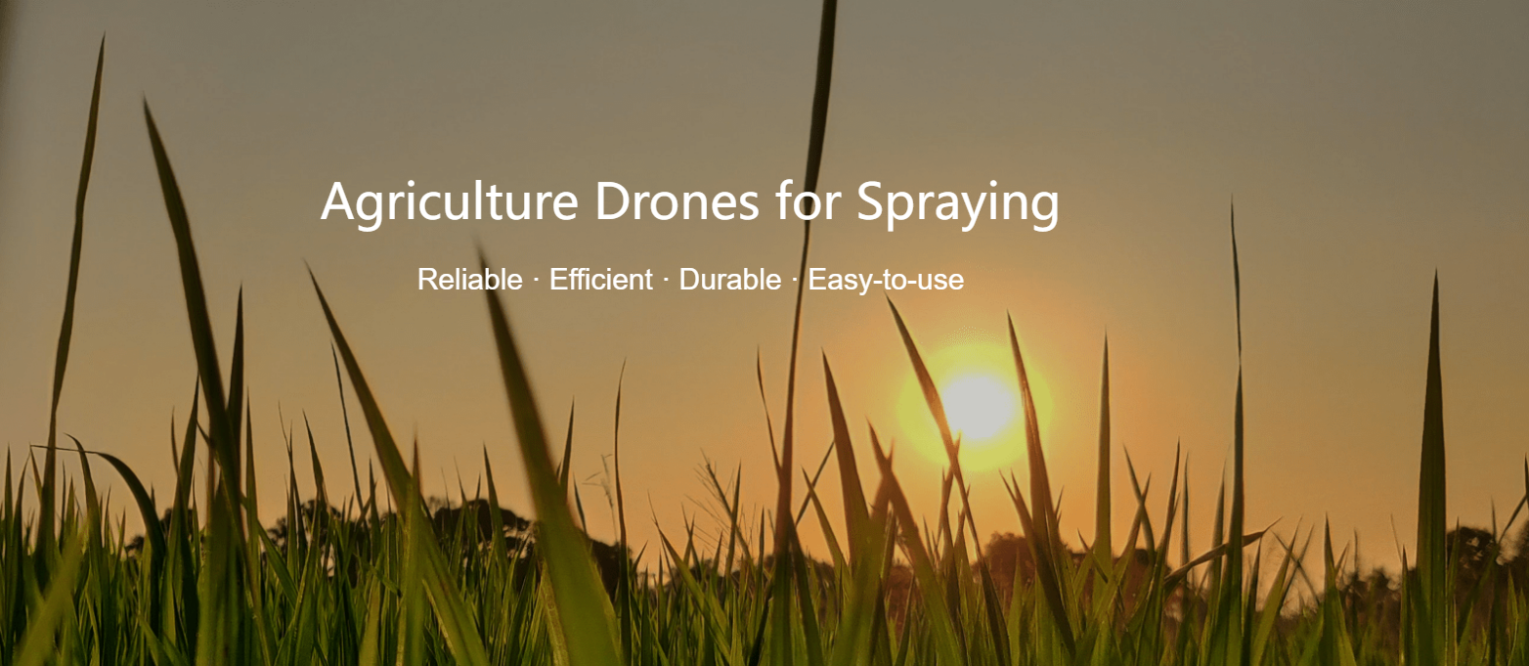
T Series
T Series T10/T12/T16

Slide 4
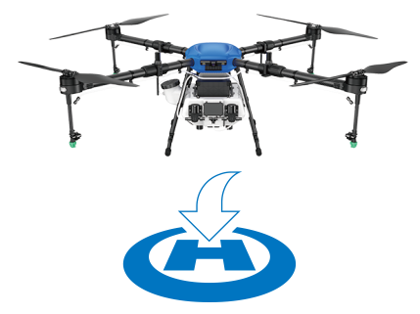
T Series
Precise Positioning : Safe Flight
It uses RTK Technology for positioning, supporting Beidou / GPS / GLONASS at the same time, and is equipped with dual anti-inference antenna to ensure centimeter-level accuracy.
The front and rear obstacle avoidance radars offers ± 10cm accuracy, effectively avoiding obstacles such as utility poles and trees.
A magnetic compass is equipped to ensure the drone flies straight in the right direction even when RTK is unavailable.
Independent landing lights are provided for safe operation at night.

Slide 5
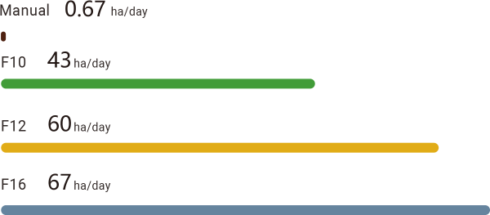
T Series
High Efficiency with Best Value
60-100 times higher efficiency than manual spraying.
F10 spays 43 ha(105 acres) per day (8 hours).
F12 sprays 60 ha (148 acres) per day (8 hours).
F16 spays 67 ha(165 acres) per day (8 hours).
Durable, Foldable and Easy to Transport
Foldable design for easy storage and transportation.
Though and durable. Metal frame and carbon fiber boom. Durable folding mechanism.
IP67 waterproof body. Shell can be washed with running water after operation.

Slide 6
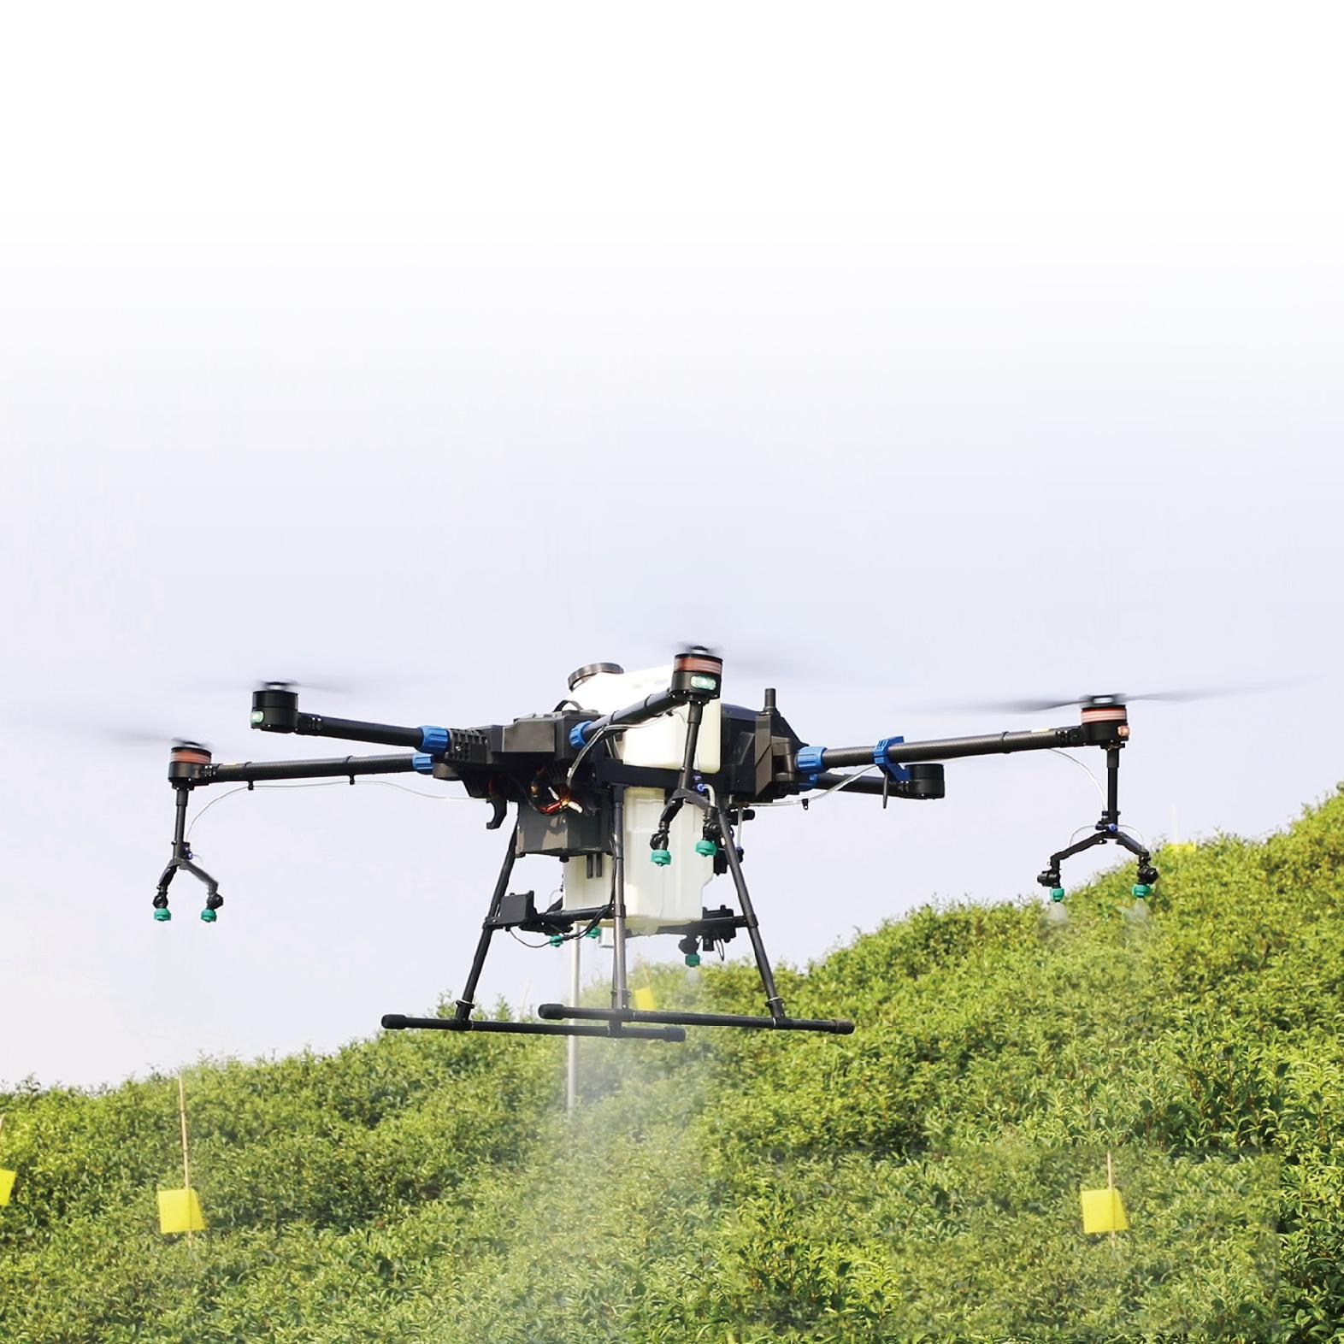
T Series
Precise and Even spraying with
High Efficiency and Good Penetration
Double pumps are equipped. The max flow rate for 4 nozzles is 2.7 L/min.Upgrade to 8 nozzles for a max flow rate of 3.5 L/min and upgrade to 8 nozzles and 2 flow meters for a max flow rate of 4.5 L/min.
High-pressure fan-shaped nozzles, providing fine atomization with a mean droplet diameter of 170 - 265 μm.
Precise metering system to avoid insufficient spraying/overdose. Real-time display of remaining volume on the RC display.
Quadcopters have larger propellers creating stable downward wind, leading to better penetration of chemicals compared with hexacopters and Octocopters.

Slide 7
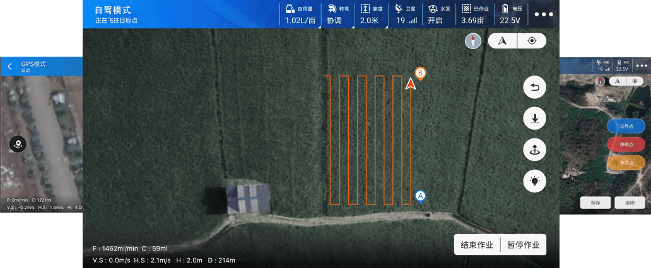
T Series
Easy to Operate, Quick to Start
5.5 inch high brightness display for the RC ensurers clear outdoor image . Battery lasts for 6-8 hours.
Multiple operation modes: A-B point, manual and autonomous. Simple setup to quickly start operation.
Comprehensive training is offered to help users independently operate in 3 days and become skillful in 7 days.

Slide 8
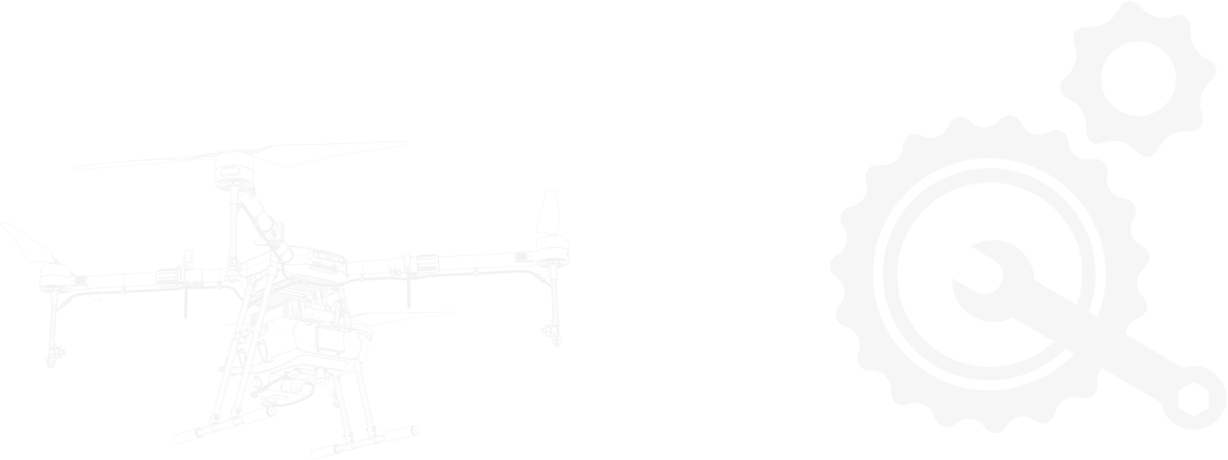

T Series
Timely After-sales Service to Protect Your Interests
Modular design: users can replace certain damaged modules by themselves instead of returning the drone to manufacturer.
Online support from our company's technical team.

Slide 9
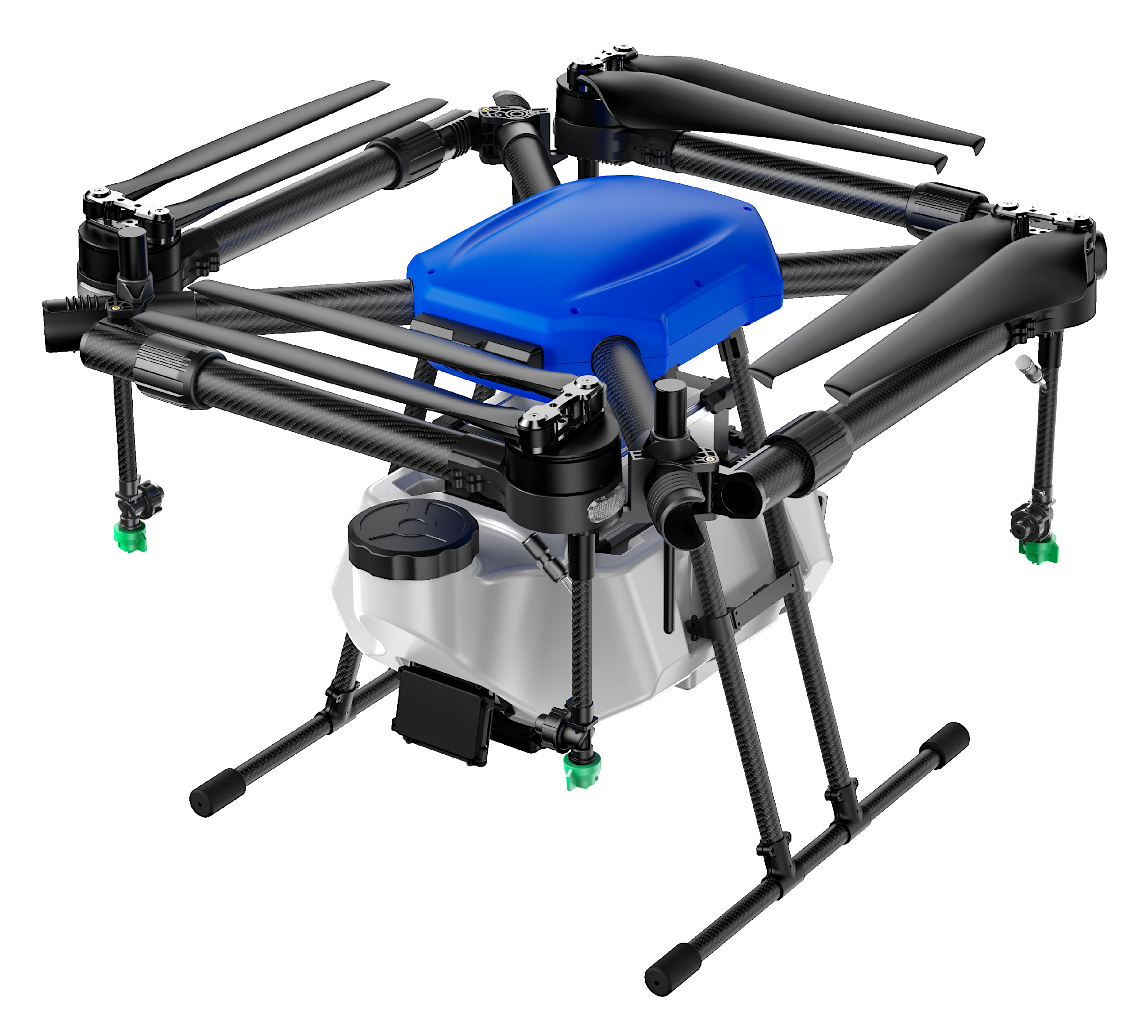
T Series
More Advanced Technology Makes the Drone Smarter
Terrain following radar is equipped to adjust the altitude of the drone to ensure flight safety and even spraying.
Predict the breakpoint according to the route plan so that users can wisely arrange the timing for refill to improve battery efficiency .
FPV (First-person view) enables user to see the environment in front of the drone in real time on the mobile phone.
The app “Plant Protection Assistant” installed on the RC provides access to operation data. Useful functions include route planning, voice broadcast, field management, operation area statistics, etc.

Slide 10
T Series
T10
Basic Parameters |  | Flight Parameters
Wheelbase | 1435mm(4 Axis） | Hover Time (Maximum Operating Power) | >20min(Unloaded)
Dimension Unfolded | 1152*1152*630mm |  | >10min(Loaded)
Dimension Folded | 665.4*666.4*630mm | Height of Homework | 1.5m-3.5m
Width of Spray | 3.0-5.5m | Maximum Flight Speed | 10m/s(GPS Model)
Tank Capacity | 10L | Hover Precision | Horizontal +_10cm
Efficiency | 80 Ha/hr |  | Vertical +_10cm(RTK Enabled)
Machine Weight | 12.25kg (Excluding Battery) | (Good GNSS Signal ) | Vertical +_0.1m(Radar Enabled)
Maximum Effective Takeoff Weight | 27.4kg | Range Accuracy of Ground Defense Radar | 0.02m
Power Battery | 12S 14000mAh | Fixed High Range | 1-10m
Nozzle Type | High Pressure Fan Nozzle | Obstacle Avoidance Perception Range | 2-12m
Nozzle Number | 4 Nozzles
Maximum Velocity | 3.6L/min

Slide 11
T Series
T12/T16
Basic parameters |  | Flight parameters
Wheelbase | 1680mm | Hover Time (Maximum Operating Power) | >20min(Unloaded)
Dimension Unfolded | 1282*1282*528mm |  | >10min(Loaded)
Dimension Folded | 691*691*528mm | Height of Homework | 1.5m-3m
Width of Spray | 4.5-6m (Different Crops) | Maximum Flight Speed | 10m/s
Tank Capacity | 12L/16L | Hover Precision | Horizontal +_10cm,Vertical +_10cm(RTK Enabled)
Efficiency | 112arc/hr |  | Vertical +_0.1m(Radar Enabled)
Machine Weight | 12.8kg (Excluding Battery) | Range Accuracy of Ground Defense Radar | 0.1m
Maximum Effective Takeoff Weight | 30.6kg | Fixed High Range | 1-20m
Power Battery | 51.8V/828.8Wh | Obstacle Avoidance Perception Range | 1-20m
Nozzle Type | High Pressure Fan Nozzle
Nozzle Number | 4 Nozzles/8 Nozzles
Maximum Velocity | 2.7L/min/4.5L/min(max)
Charger output | 2600W(4 Channels)

Slide 12
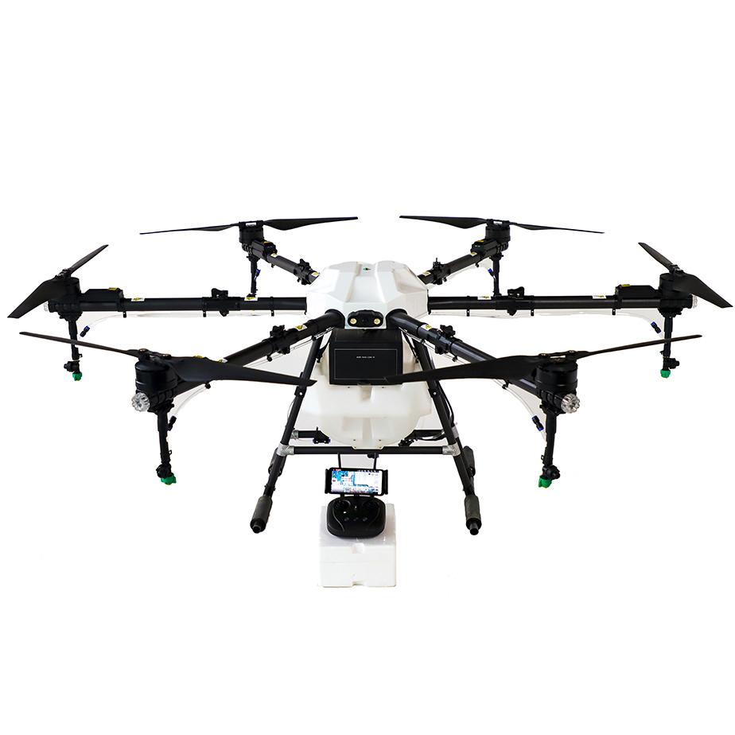
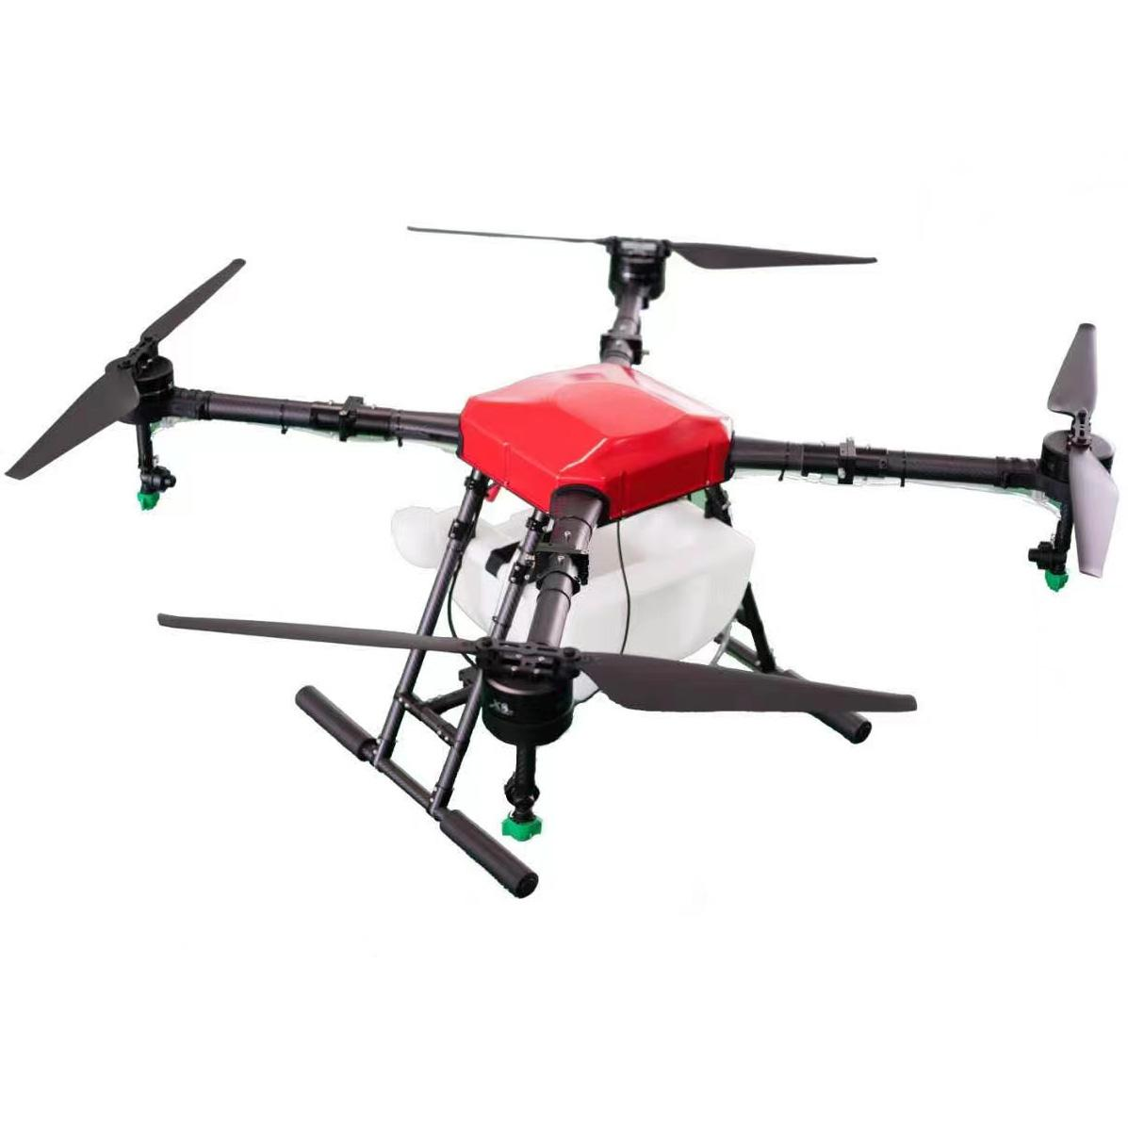
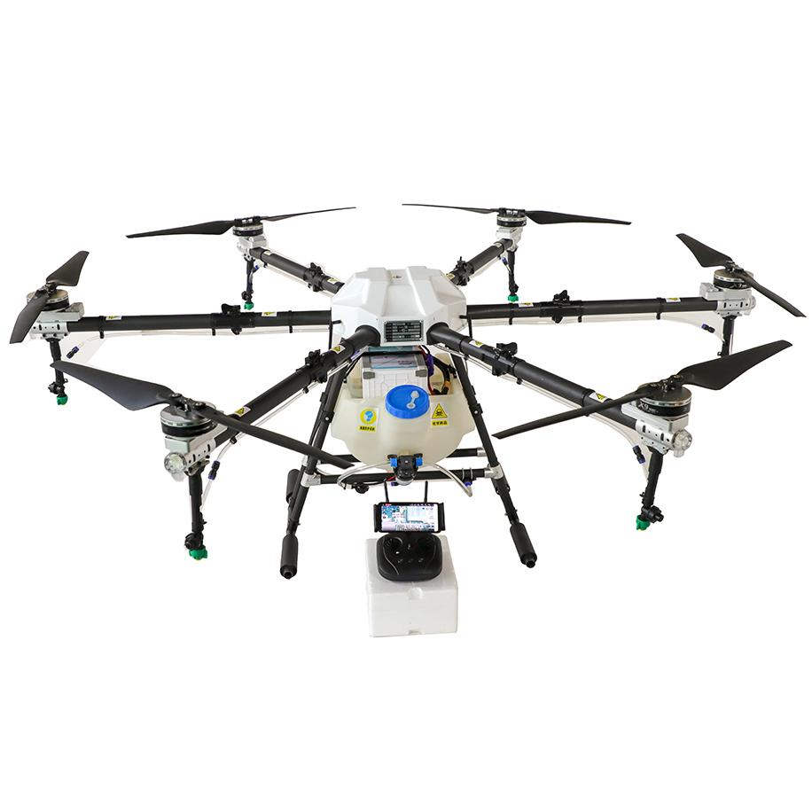
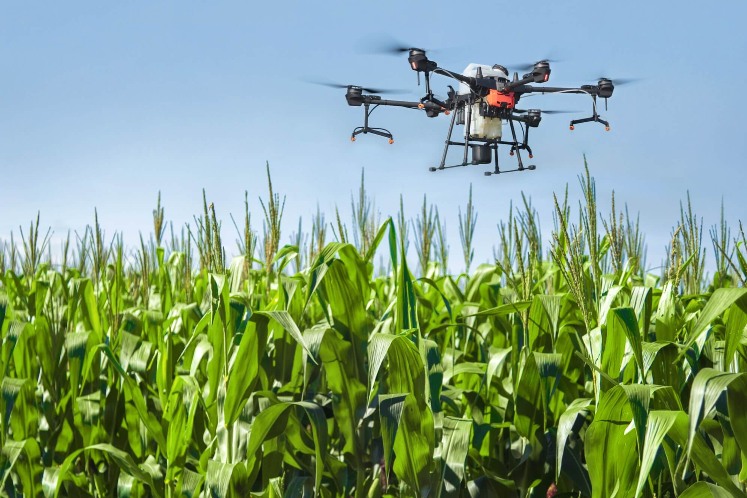
Y Series
Y Series Y20/Y22/Y30

Slide 13
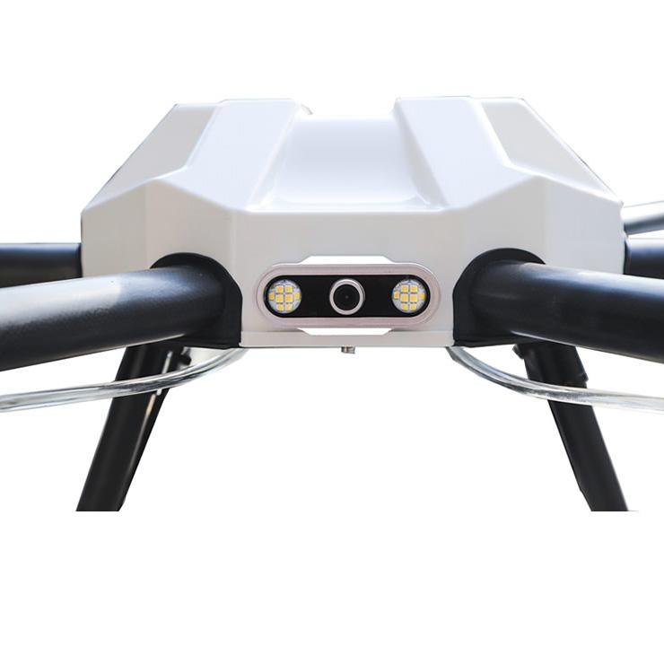
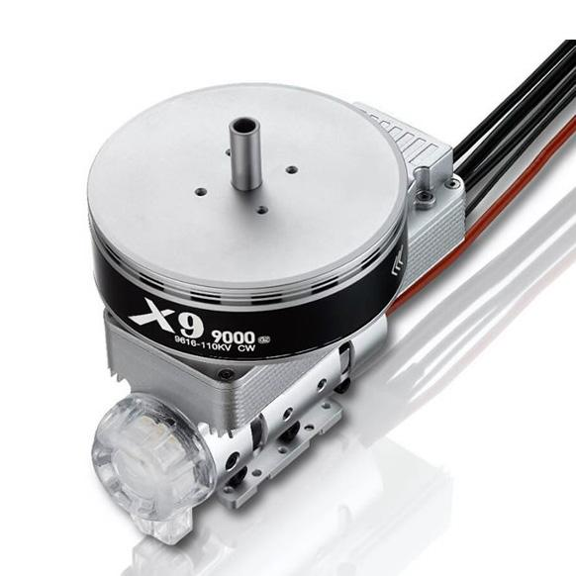
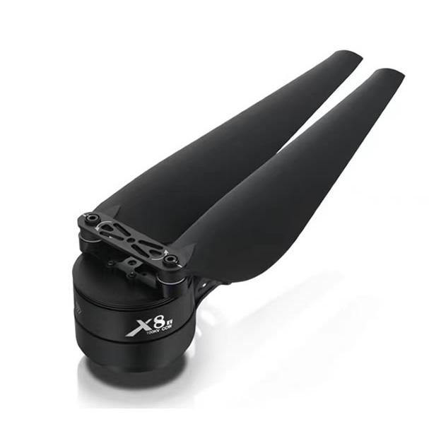
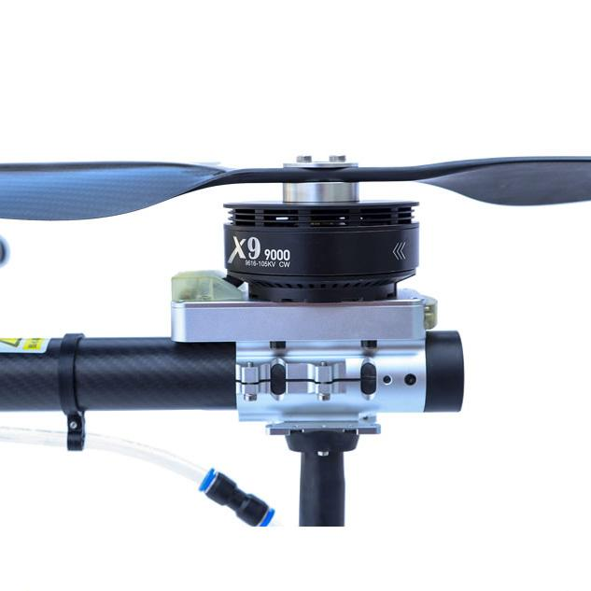
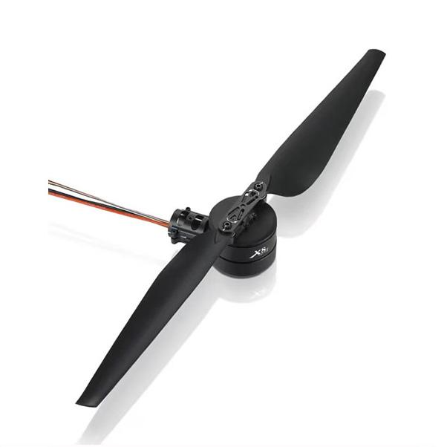
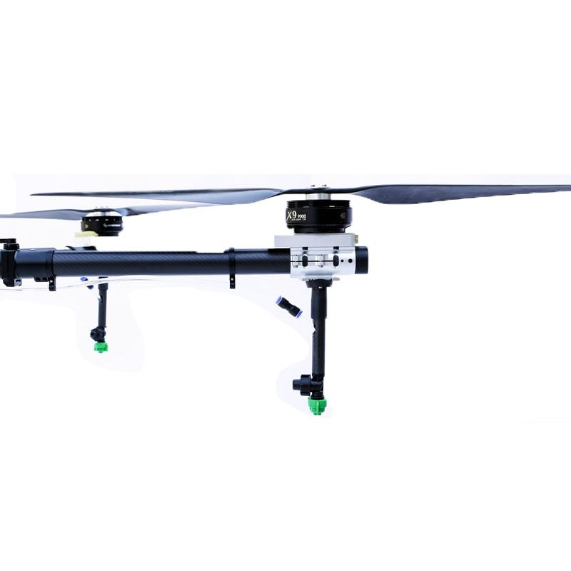
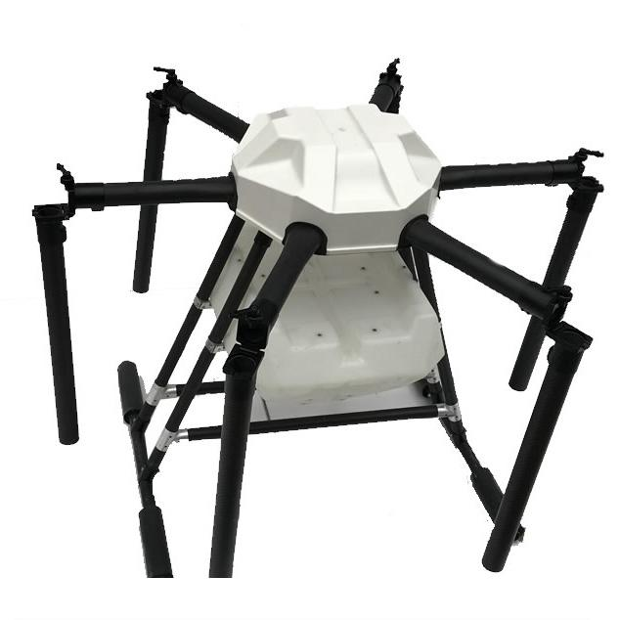
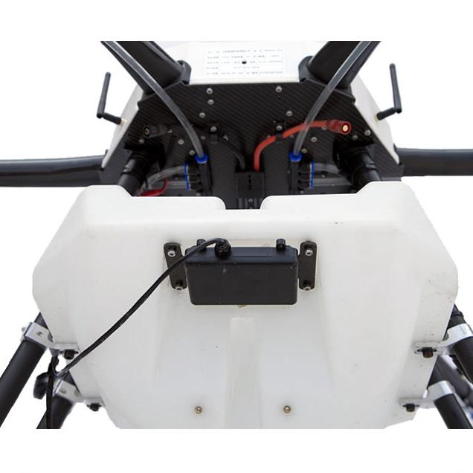
Y Series

Slide 14
Model 型号 | Y16 | Y20 | Y30
Pesticide Tank 水箱 | 16L | 20L | 30L
Net Weight 净重 | 18.4 kgs | 25.4 kgs | 32.9 kgs
Take-off Weight 起飞重量 | 35 kgs | 48 kgs | 65kgs
Flying Time 飞行时间 | 10-25min | 10-25min | 10-25min
Flying Radius 飞行半径 | 1000m | 1000m | 1000m
Flying Height 飞行高度(一般农作物打药高度1.5M），解禁可飞200M | 0-20m | 0-20m | 0-20m
Flying Speed 飞行速度 | 0-8m/s | 3-8m/s | 3-8m/s
Work Temperature 工作温度 | -20~40°C | -20~40°C | -20~40°C
Work Humidity 工作湿度 | 0~90% | 0~90% | 0~90%
Spray Speed 喷洒速度米/秒 | 0-8m/s | 0-8m/s | 0-10m/s
Spray Width 喷洒宽度 | 2-4m/s | 5-8m/s | 5-8m/s
Nozzle No. 喷嘴数量 | 4 pcs | 6 pcs | 8 pcs
Spray Flow 喷洒流量升/分钟 | 3L/min | 5L/min | 8L-10L/min
Spray Efficiency 喷洒效率公顷/小时 | 4-8 hectare/hour 1-2亩/分 | 6-12 hectare/hour 1.5-3亩/分 | 6-14hectare/hour
Wind Resistance 风阻 | 10m/s | 10m/s | 10m/s
Y Series
Model 型号 | Y16 | Y20 | Y30
Pesticide Tank 水箱 | 16L | 20L | 30L
Net Weight 净重 | 18.4 kgs | 25.4 kgs | 32.9 kgs
Take-off Weight 起飞重量 | 35 kgs | 48 kgs | 65kgs
Flying Time 飞行时间 | 10-25min | 10-25min | 10-25min
Flying Radius 飞行半径 | 1000m | 1000m | 1000m
Flying Height 飞行高度(一般农作物打药高度1.5M），解禁可飞200M | 0-20m | 0-20m | 0-20m
Flying Speed 飞行速度 | 0-8m/s | 3-8m/s | 3-8m/s
Work Temperature 工作温度 | -20~40°C | -20~40°C | -20~40°C
Work Humidity 工作湿度 | 0~90% | 0~90% | 0~90%
Spray Speed 喷洒速度米/秒 | 0-8m/s | 0-8m/s | 0-10m/s
Spray Width 喷洒宽度 | 2-4m/s | 5-8m/s | 5-8m/s
Nozzle No. 喷嘴数量 | 4 pcs | 6 pcs | 8 pcs
Spray Flow 喷洒流量升/分钟 | 3L/min | 5L/min | 8L-10L/min

Slide 15
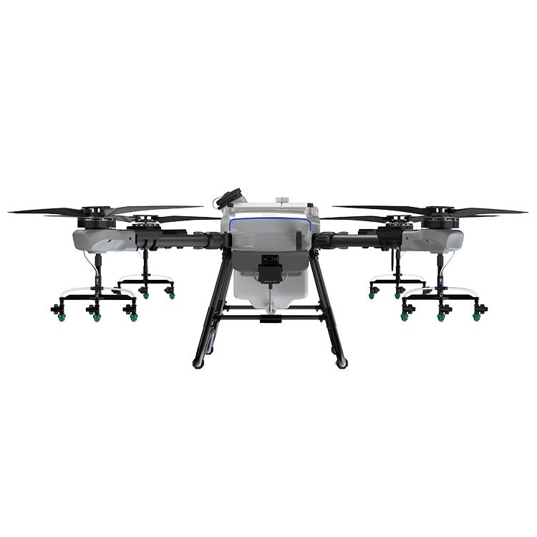
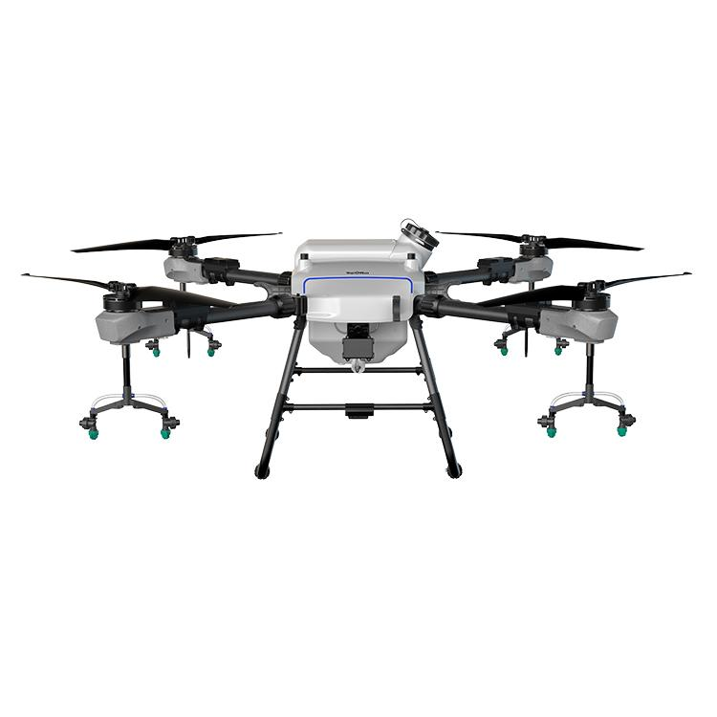
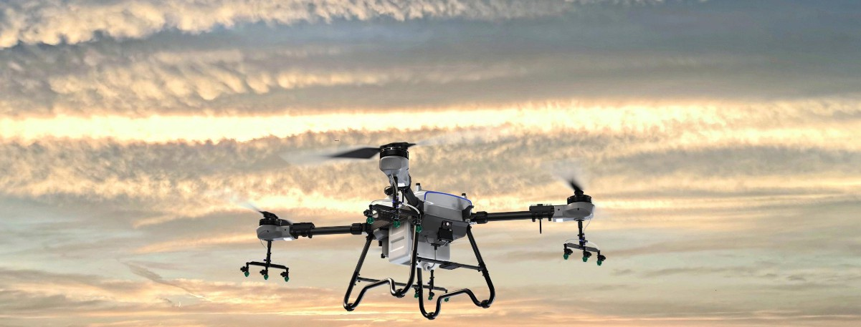
Q Series
Q Series Q200/Q300
A worry-free high-tech agricultural machine
IP67 module-level protection
Modular design The consumable parts can be easily replaced by users

Slide 16
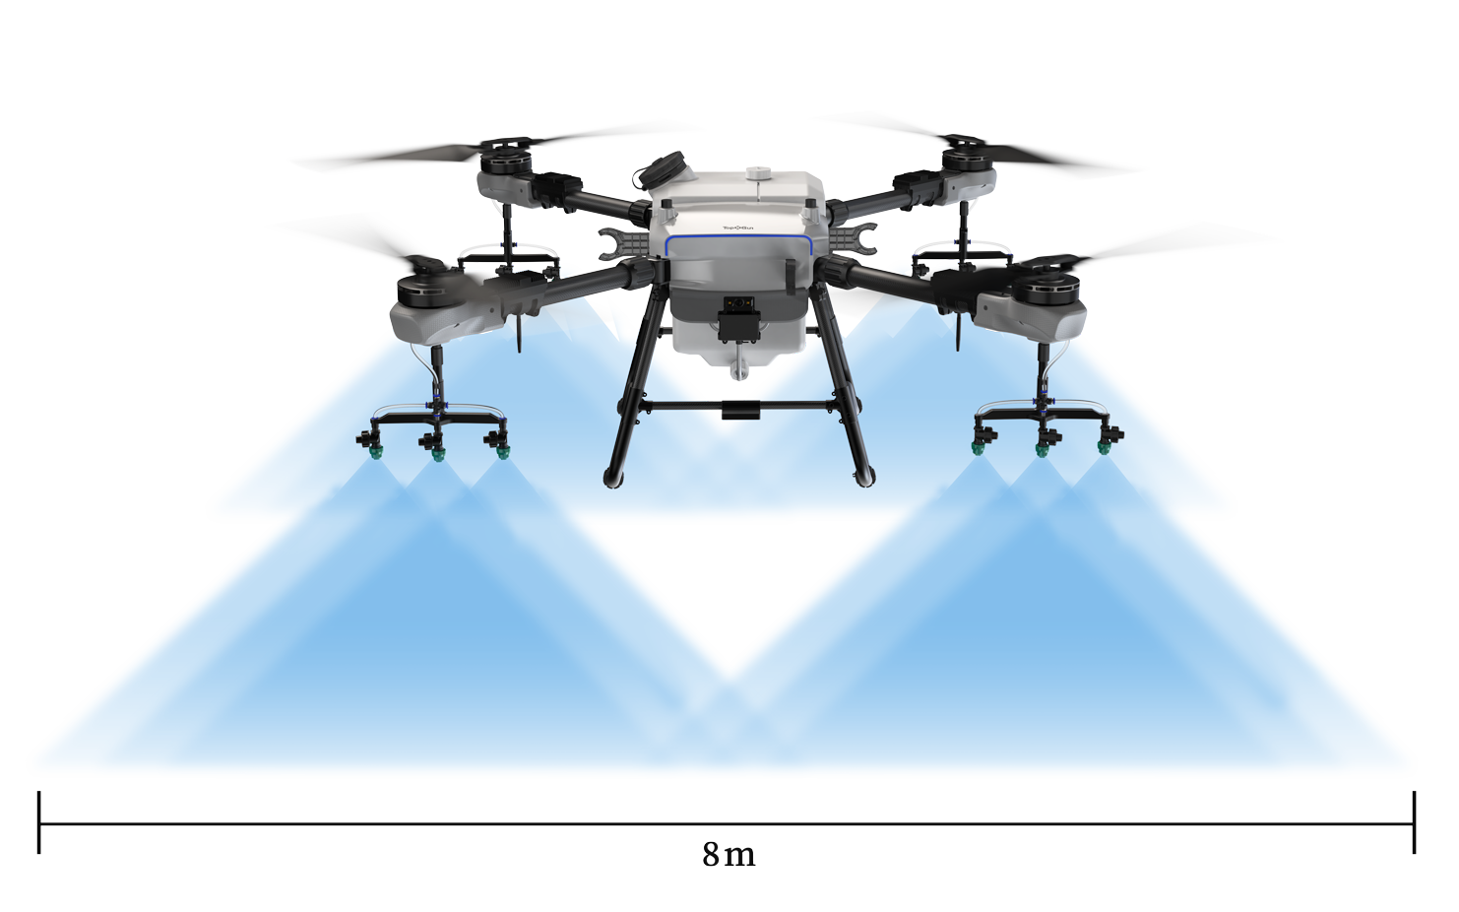

Q Series
Excellent Spraying Performance
30L tank for spraying Efficiency of FP300 has been increased to 14.6 ha/hr.
Auto pressure relief valve.
High pressure nozzle ensures no drifting Support centrifugal nozzle. Powder agrochemical will not block the pipe.
Full-range continuous level meter. The real-time level will be shown on the APP.

Slide 17
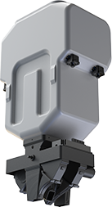
Q Series
Effectiveness and Evenness of Spreading
45L container，7m spreading range
Air jet spreading system
Spread evenly, and no harm to the seeds
IP67, waterproof and no corrosion
No blocking anymore, and water washable
Real-time weight monitoring
Overloading is prevented

Slide 18
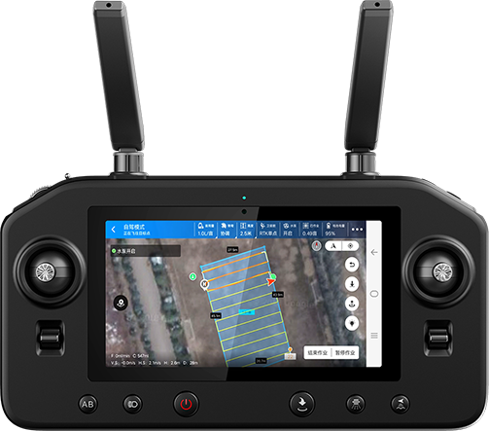
Q Series
Easy and efficient
3 operation modes including AB Points, full autonomous and manual mode.
Field surveying modes: RTK T-marker, drone surveying and selecting on the map.
High-definition touch-screen RC which can work for 6-8 hours continuously High brightness; clearly visible even in the sunny outdoor environment.
Border line scanning function will generate routes automatically. No omission of spray/spreading
Equipped with FPV auxiliary lights and landing light Working at night becomes easy and safe
The battery can be fully charged in 10 mins. 2 batteries and 1 charger are enough for non-stop operation

Slide 19
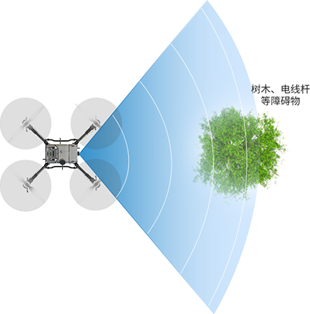
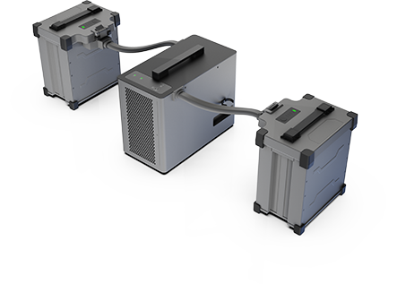
Q Series
A Durable Drone to Meet Your Expectation
High strength navigational aluminum frame
Critical components are enclosed
Keep dust and agrochemical outside
Battery life: more than 1000 cycles
Smart assist function, ensure the flight safety
Detect the obstacles from 40m away and circumvent obstacles automatically
The terrain following radar and obstacle avoidance radars providing a safer operation experience
A front and a rear 720p HD FPVs The rear one can face downwards enabling a real-time view of the ground
1000 Cycles

Slide 20
Q Series
Q200 Tech Specs |  |  |  |  | Q300 Tech Specs
Wheelbase | 1970mm | Drone Weight | 38.4kg(incl.battery) |  | Wheelbase | 1970mm | Drone Weight | 43.6kg(incl.battery)
Battery | 30Ah(51.8V) | Charging | 8-12mins |  | Battery | 30Ah(51.8V) | Charging | 8-12mins
Rated Takeoff Weight | 58.5kg | Hover | 25mins(empty) 12mins(loaded) |  | Rated Takeoff Weight | 73.7kg | Hover | 20mins(empty) 8mins(loaded)
Tank | 20L | Container | 35L |  | Tank | 30.1L | Container | 45L
Nozzle Type | High-Pressure Nozzle | Feeding Method | Rolling feeder |  | Nozzle Type | High-pressure nozzle | Feeding Method | Rolling feeder
Nozzle Number | 8 | Diffusing Method | Adjustable air |  | Nozzle Number | 12 | Diffusing Method | Adjustable air
Max Flow Rate | 5.4L/min | Spreading Speed | 50L/min |  | Max Flow Rate | 8.1L/min | Spreading Speed | 50L/min
Spraying Width | 5-8m | Spreading Width | 1-7m |  | Spraying Width | 6-8m | Spreading Width | 1-7m

Slide 21

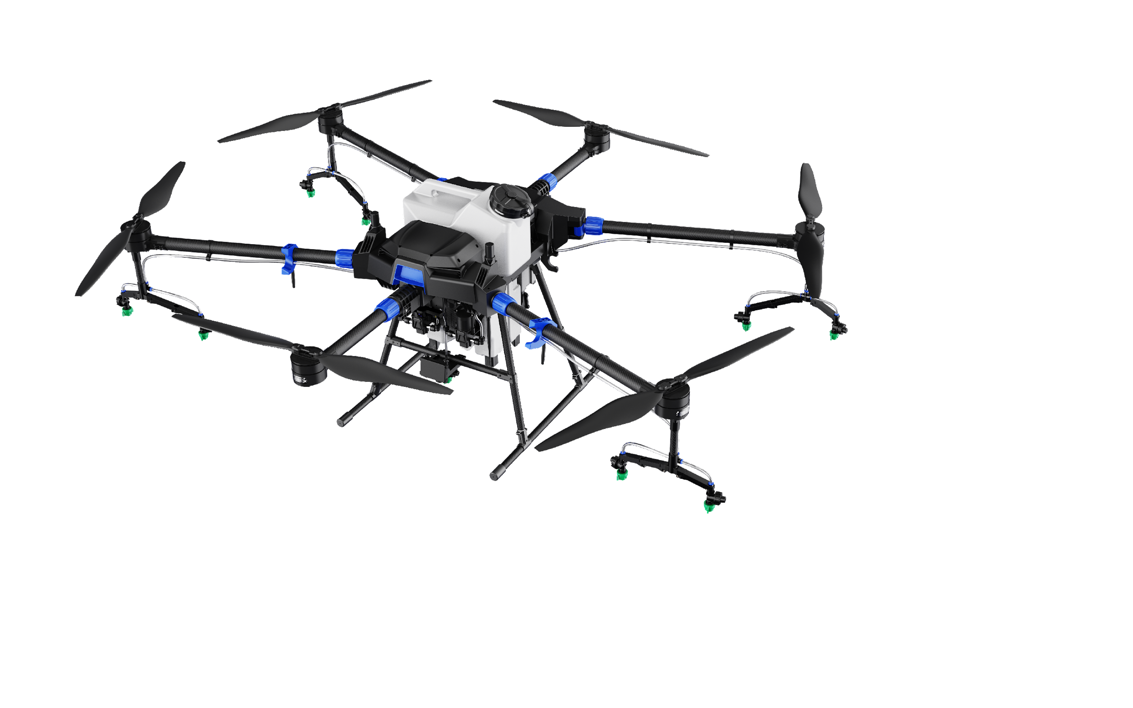
G Series
G Series G26

Slide 22
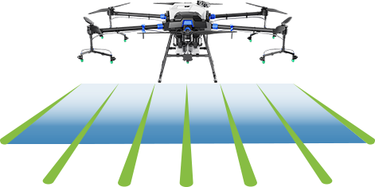
G Series
Outstanding Capacity
Higher Efficiency
120 hectares/day, which is 180 times the efficiency of manual spraying.
The drone is equipped with a landing light to ensure night time operation safety.
High-power charger can connect to 4 batteries at the same time. A battery can be fully charged from 30% in less than 30 minutes.

Slide 23
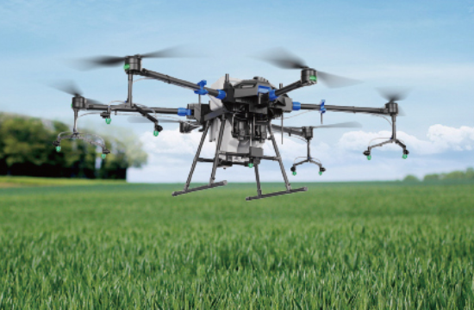
G Series
Precise and Even Spraying with
High Efficiency and Good Penetration
Equipped with dual pumps, 9 nozzles, dual flow meters. The max flow rate is 6L/min.
High pressure fan flat nozzles, providing fine atomization with a mean droplet diameter of 170-265 μm.
Precise metering system to avoid insufficient spraying/overdose.
Real-time displayed remaining volume on RC (Plant Protection Assistant APP).

Slide 24

G Series
One Drone, Two Applications
The spraying system can be replaced by spreading system by easy steps. G26 can be used for seed sowing, fertilizing, fish feeding and plant protection.

Slide 25
G Series
Easy to Operate, Quick to Start
Comprehensive training is offered to help users independently operate in 3 days and become skillful in 7 days.
5.5-inch high brightness display for the RC ensures clear outdoor image. Battery lasts for 6-8 hours.
Multiple operation modes: A-B point, manual and autonomous. Simple setup to quickly start operation.

Slide 26
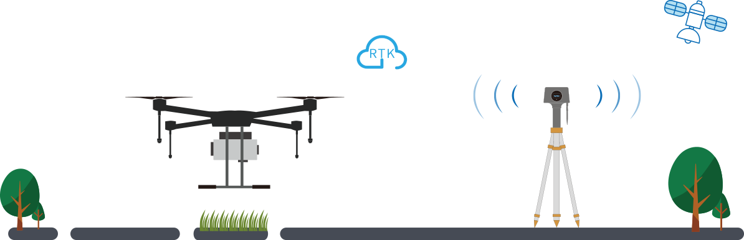
G Series
Precise Positioning,
Safe Flight
RTK positioning technology, supporting Beidou / GPS / GLONASS, and equipped with dual anti-inference antenna.
Centimeter-level accuracy ensures the drone taking off and landing at the same point.
A magnetic compass is equipped to ensure the drone flies straight in the right direction even when RTK is unavailable.
The front and rear obstacle avoidance radars offers ± 10cm accuracy, effectively avoiding obstacles such as utility poles and trees.

Slide 27
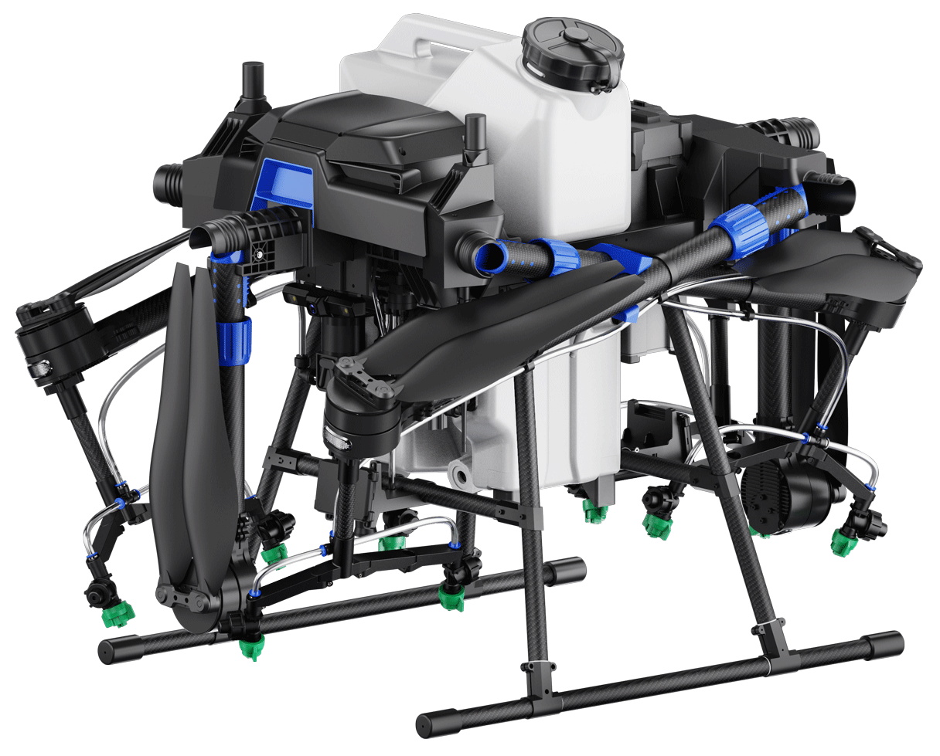
G Series
Durable, Foldable and Easy to Transport
Foldable design for easy storage and transportation.
Tough and durable. High strength carbon fiber arm, and high toughness folding structure.
The drone body is IP67 waterproof, which can be washed with running water after operation.

Slide 28
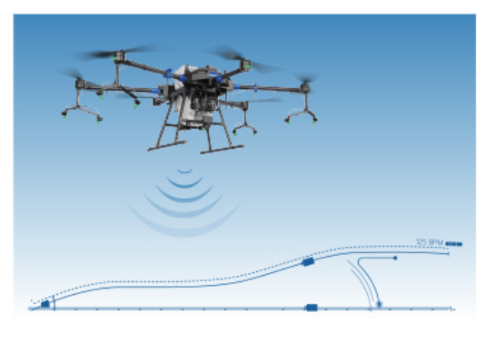
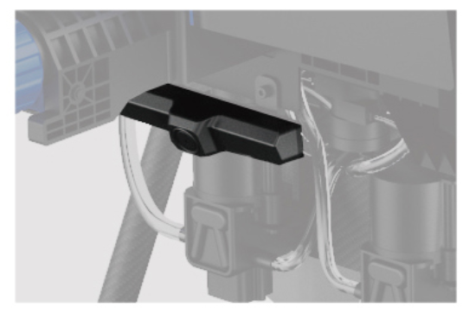
G Series
More Advanced Technology Makes the Drone Smarter
Terrain following radar is equipped to adjust the altitude of the drone to ensure flight safety and even spraying.
Predict the breakpoint according to the route plan so that users can wisely arrange the timing for refill to improve battery efficiency.
FPV (First-person view) enables user to see real-time 720p image of the environment in front of the drone on the RC display.
Users can check operation data on the Plant Protection Assistant APP installed in the RC, which provided with route planning, voice broadcast, field management, and operation area statistics, etc.

Slide 29
G Series
Tech Specs
Wheelbase | 2034mm（6-Axis） | Weight | 24.2kg(exdd.battery)
Dimension | 2660*2474*780mm(Unfolded) | Max Takeoff Weight | 59.5kg
 | 1095*620*780mm(Folded) | Battery | 2400mAh@14S(58.8V）
Width of Spray | 5-8m(9 nozzles,depending on different crops) | Nozzle Type | High-pressure nozzle
Tank Capacity | 26L | Nozzle Number | 9 nozzles
Efficiency | 14.67 Ha/hr | Max Flow Rate | 6L/min
Hovering Time | 20min(Unloaded) 9min(Loaded) | Positioning Accuracy | Horizontal +_10cm Vertical +_10cm(RTK enabled)
Operation Height | 1.5m-3m | Terrain Following Accuracy | 0.1m
Max Flight Speed | 8m/s | Obstacle Avoidance Detection Range | 1-20m

Slide 30
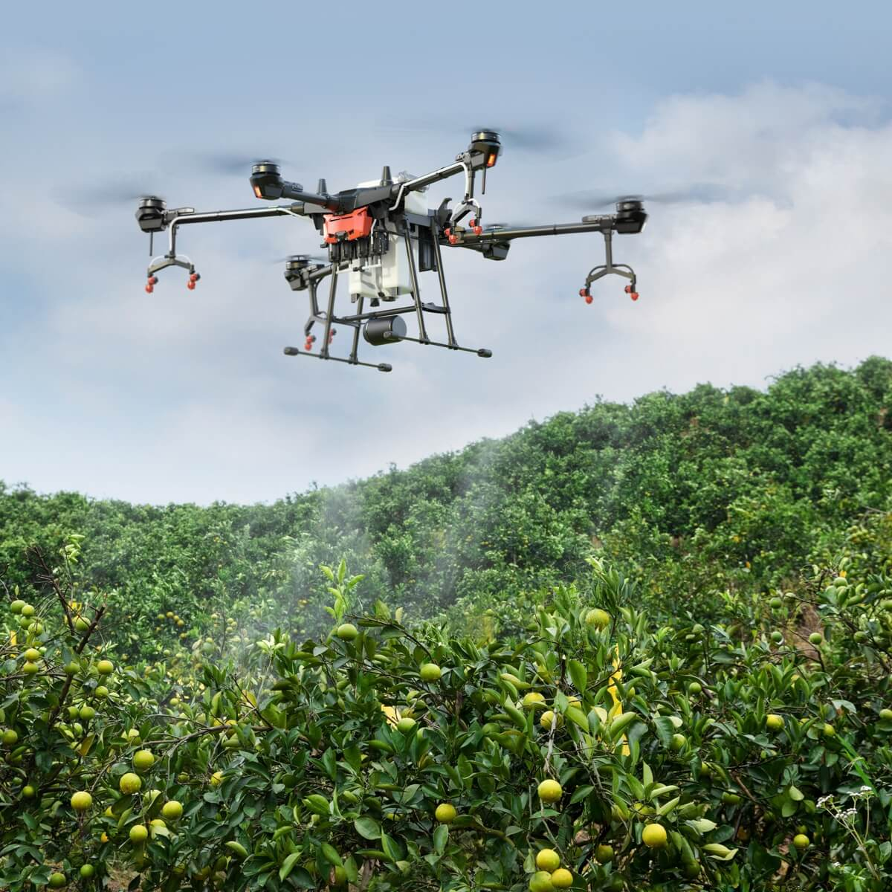
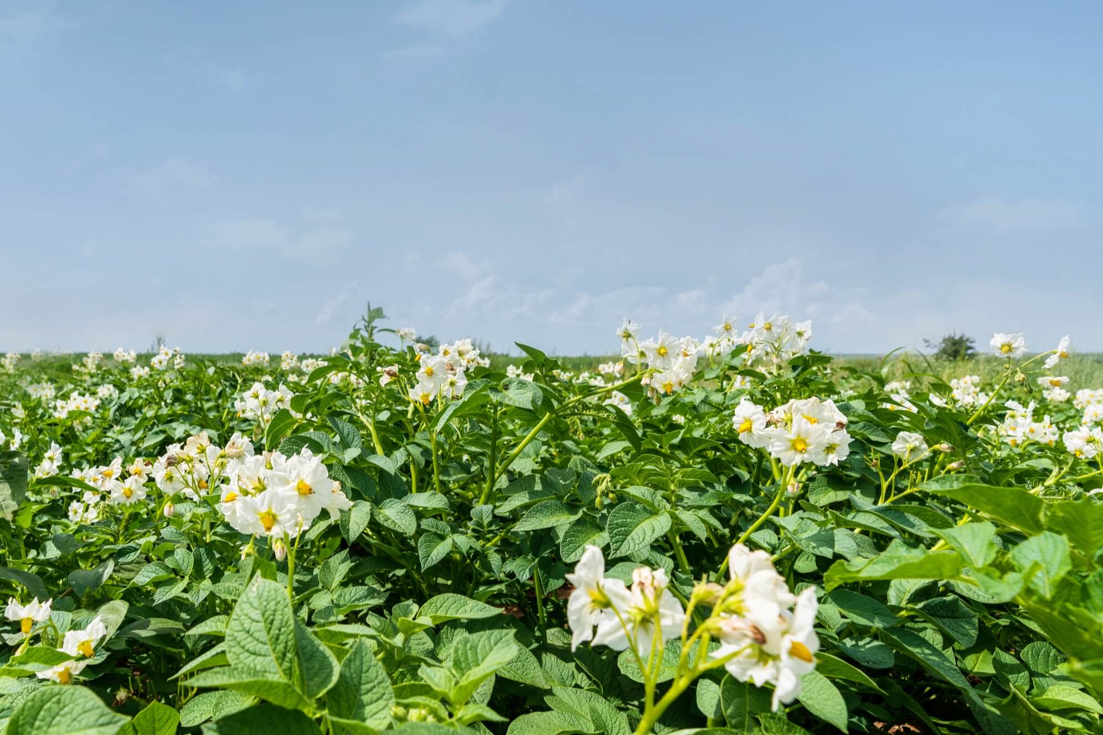
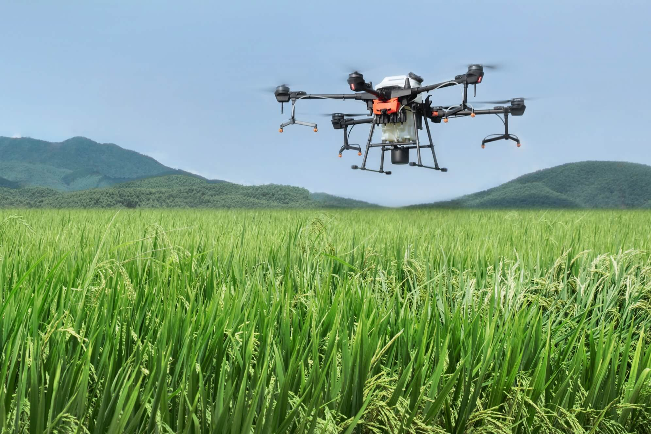
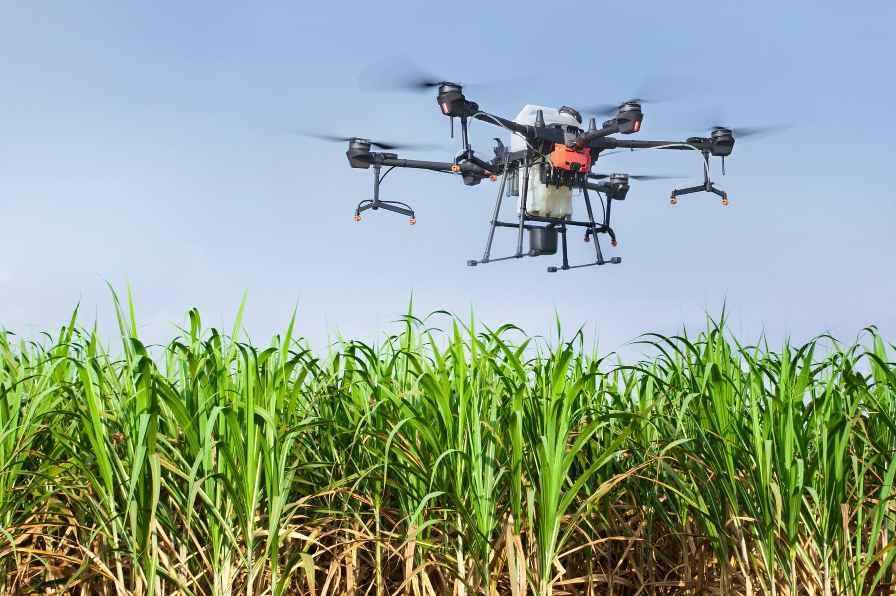
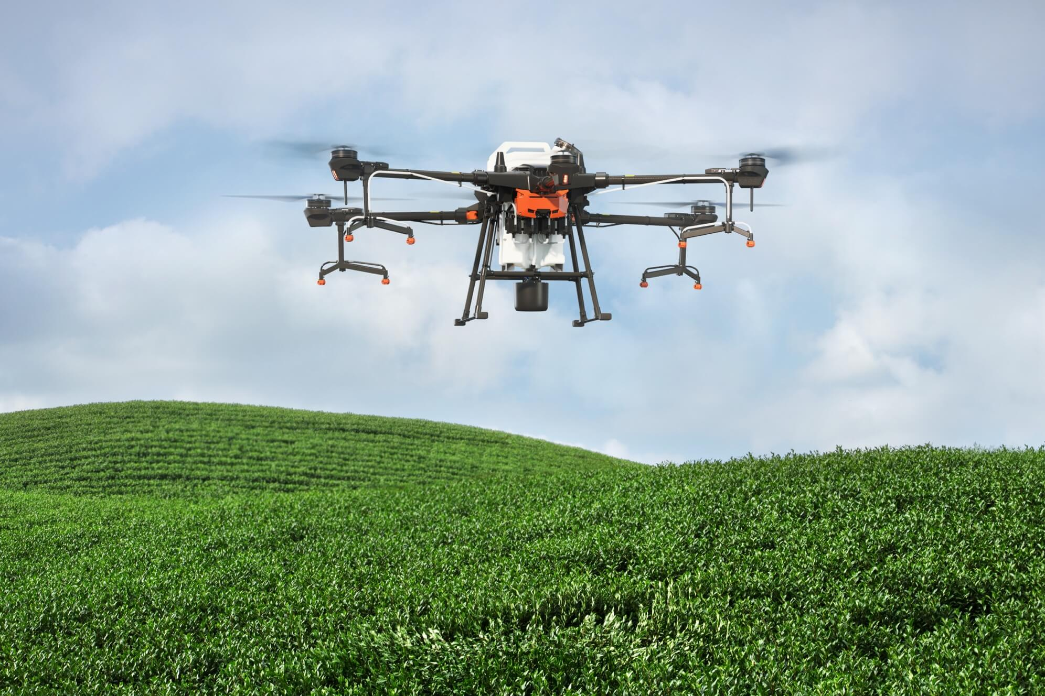
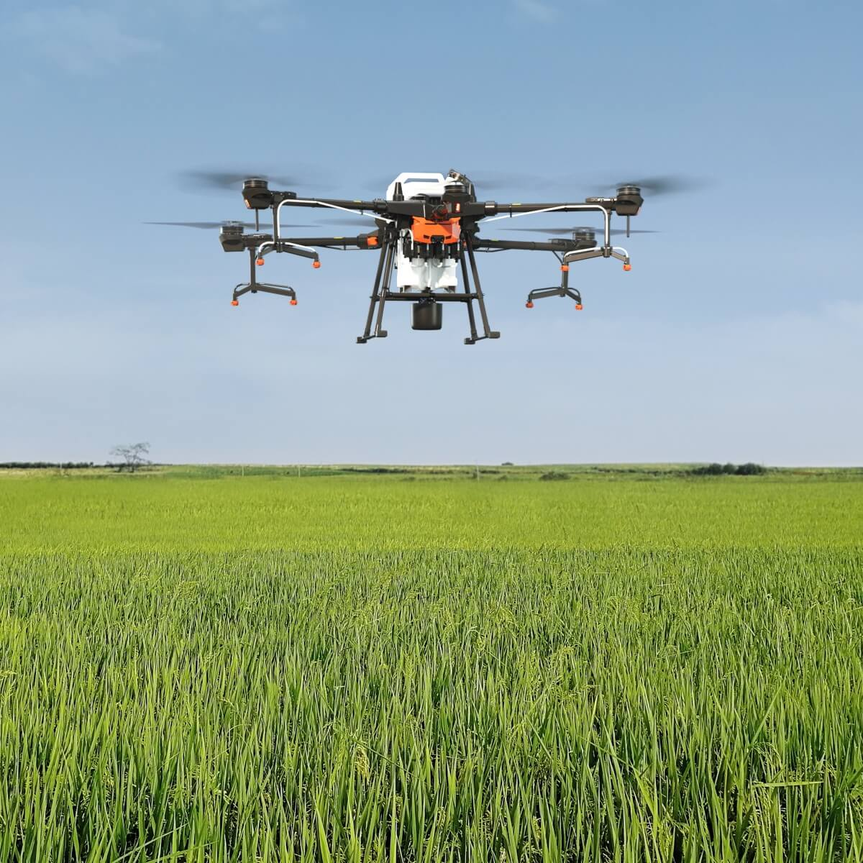
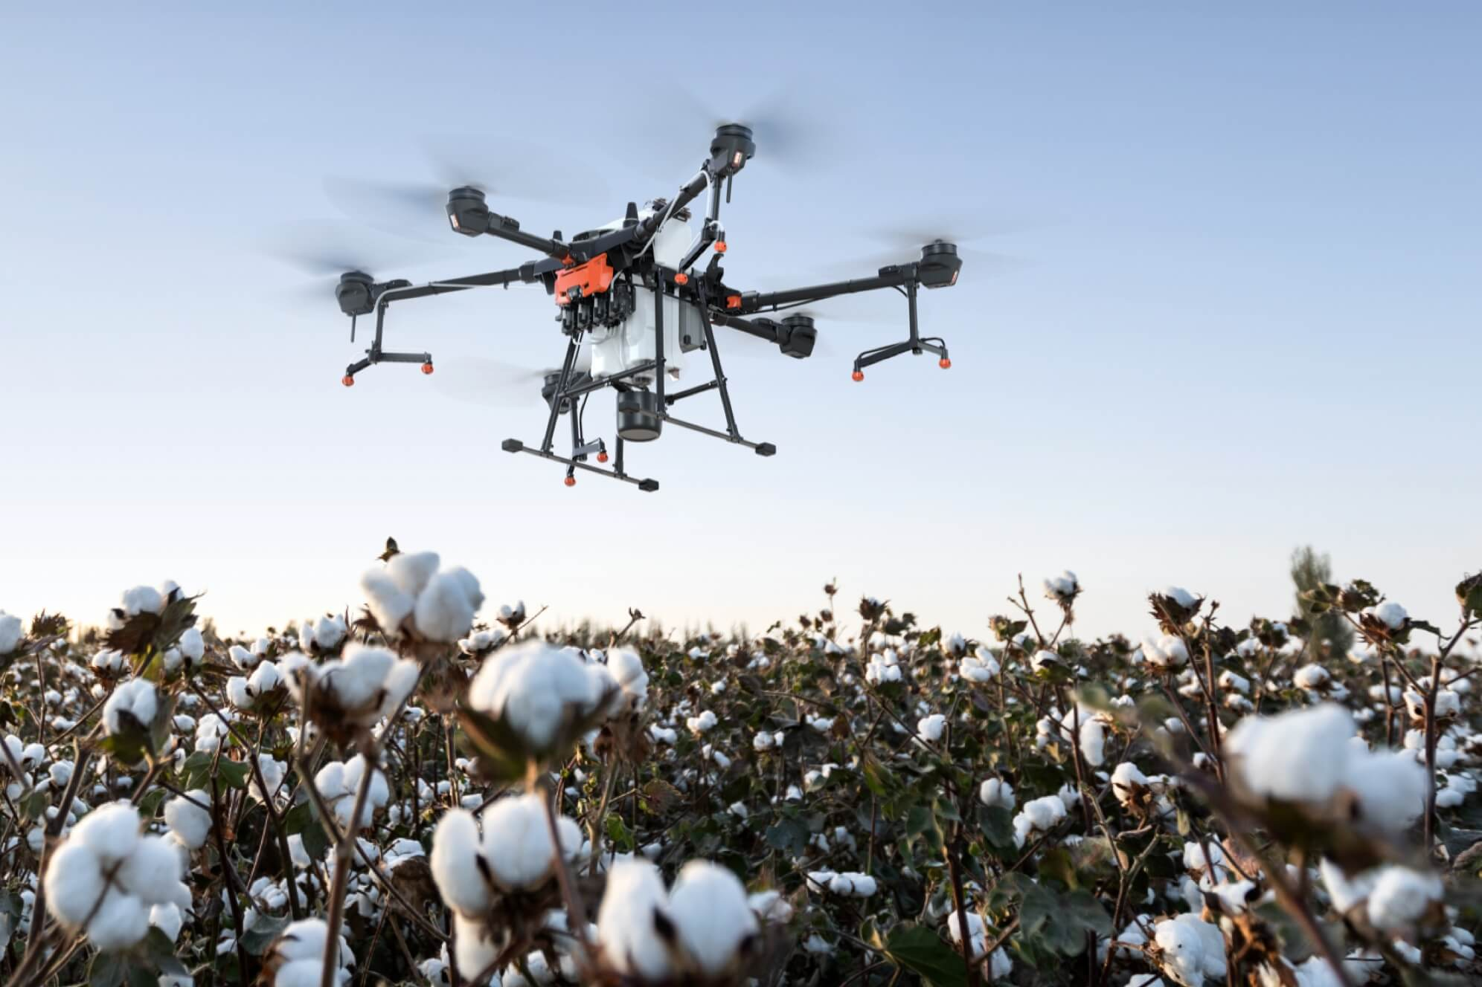
Agriculature

Slide 31
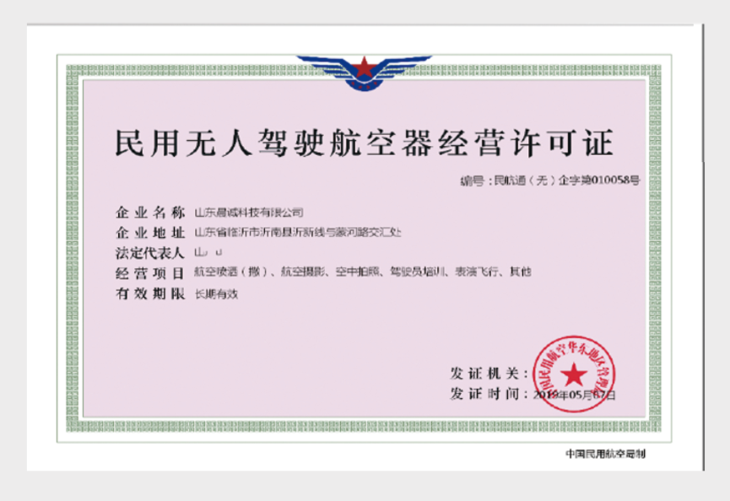
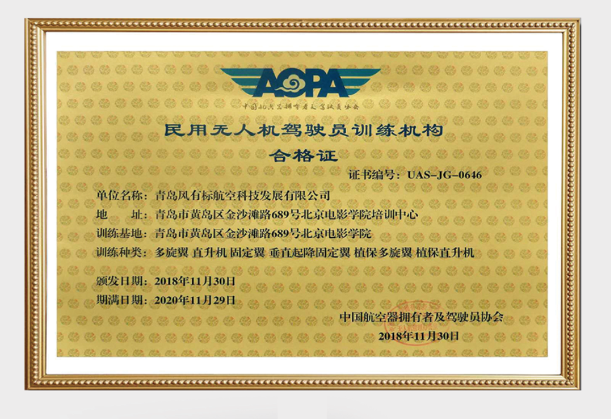
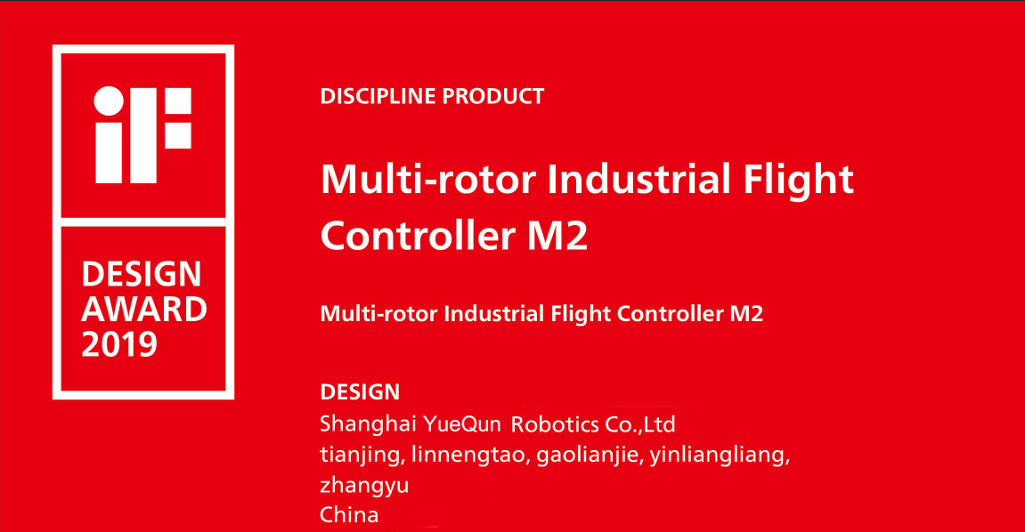

Certifications

Slide 32







Partners

Slide 33






Company Profile

